Slide 1

SteppingStone 3.0
Nevin Katz
nkatz@edc.org

Slide 2
BASA Overview
60 teachers, 1655 3rd grade pupils
Urban and Mountain Schools
20-week, 16-week, & 12-week pilots, depending on school
App is used to extend learning gains in phonics, spelling, and reading from leveled readers
Schools with 1:1 student:tablet ratios have a home reinforcement program

Slide 3
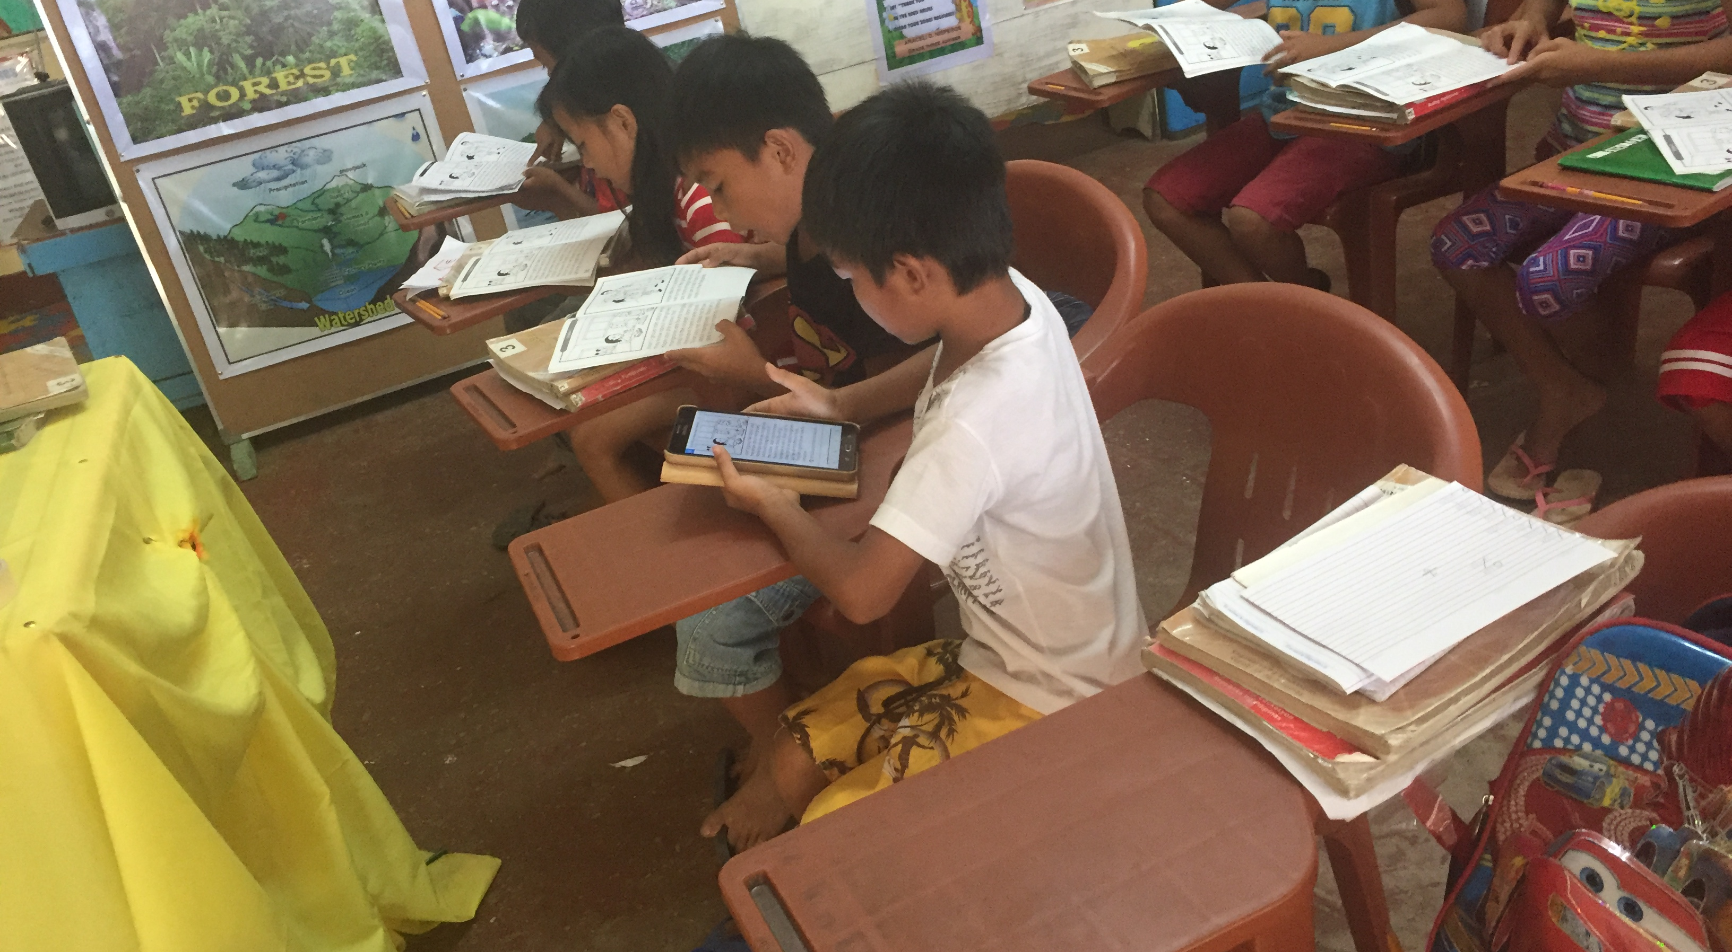
Leveled Readers

Slide 4
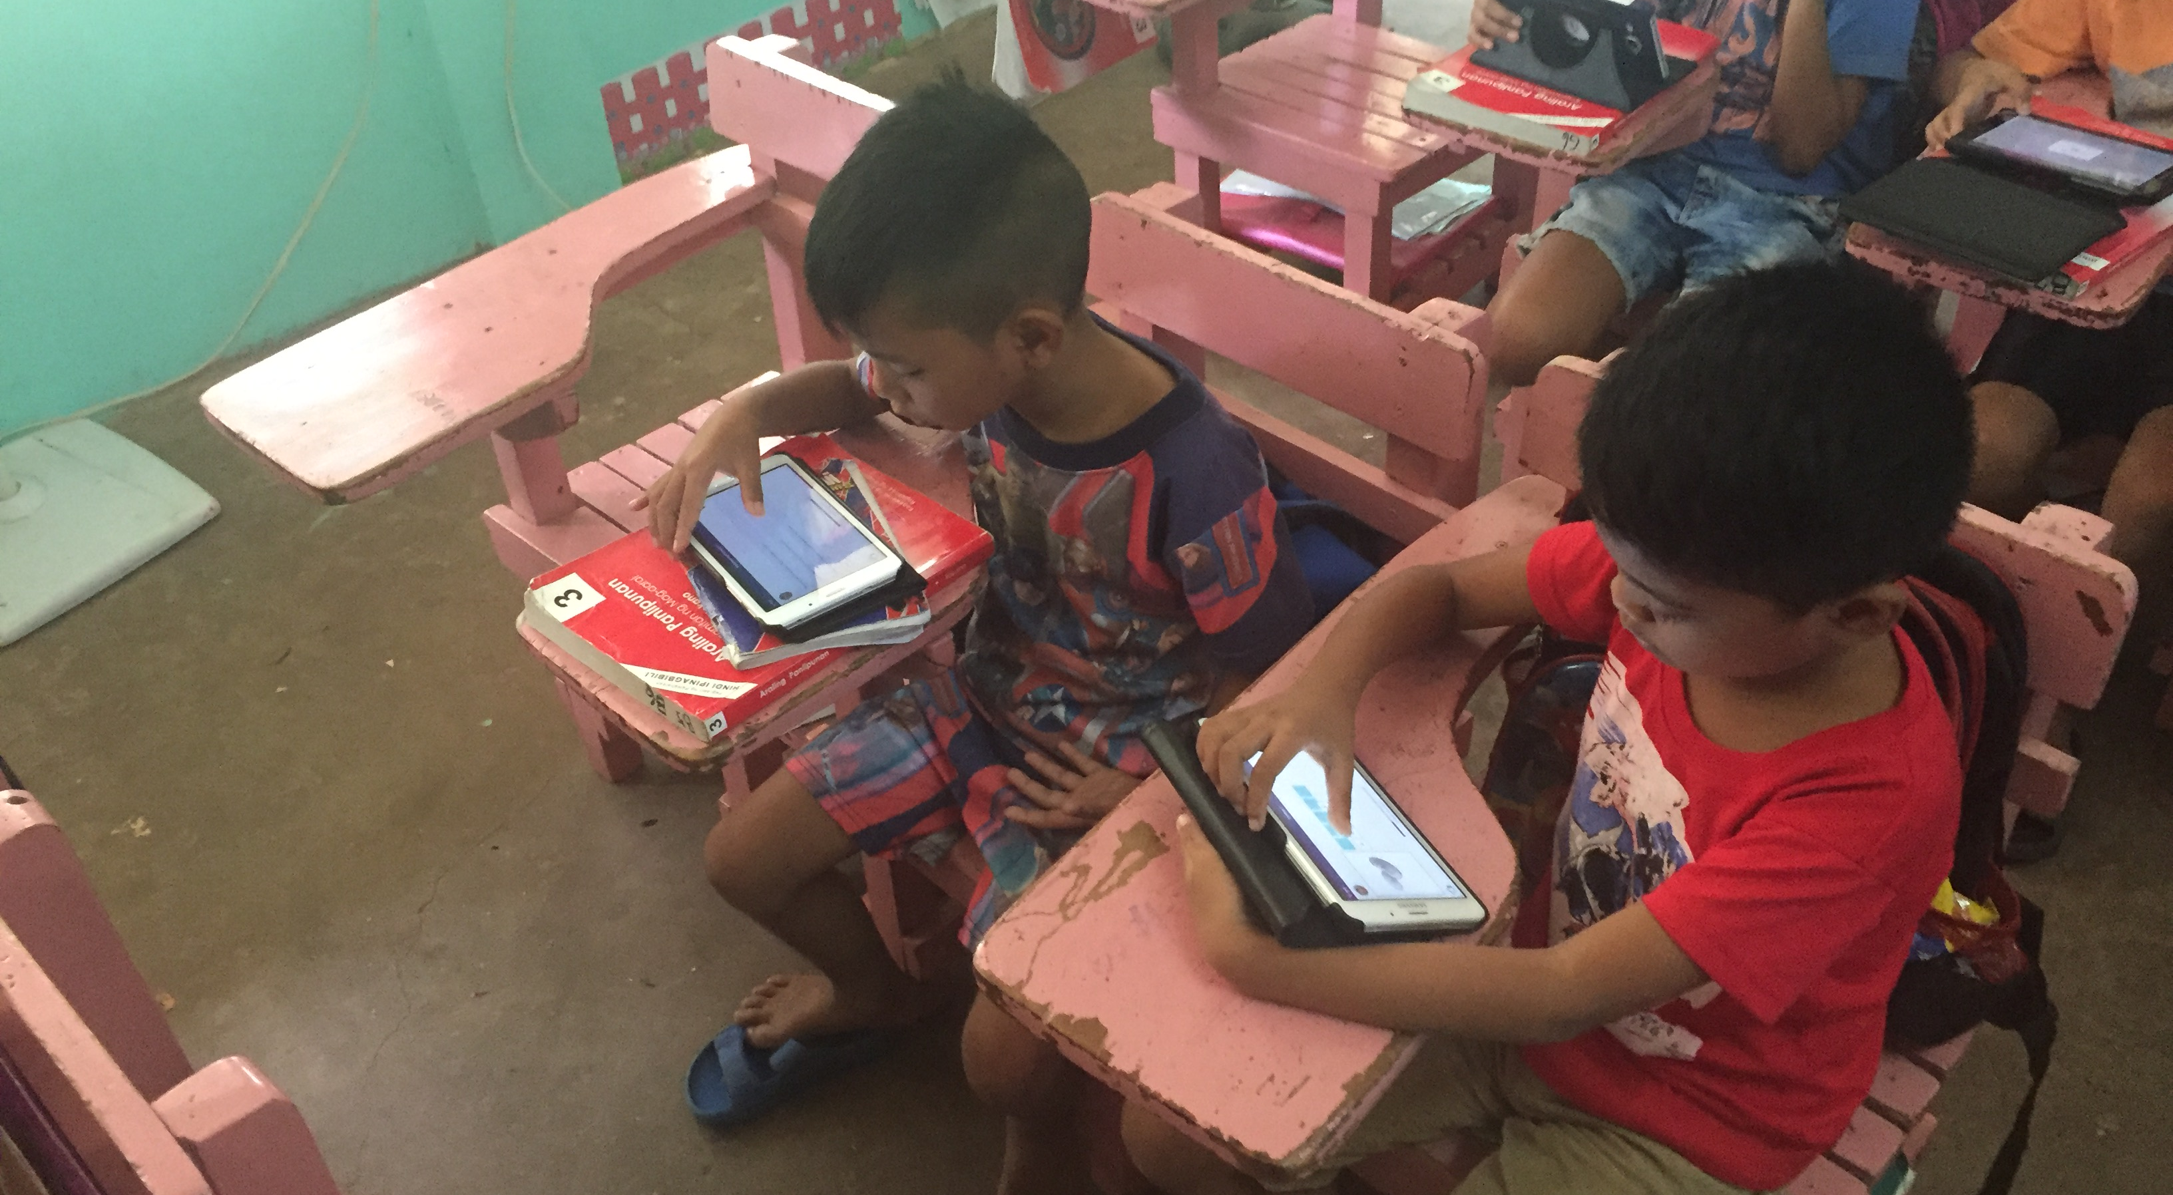
App extends reader content with exercises

Slide 5
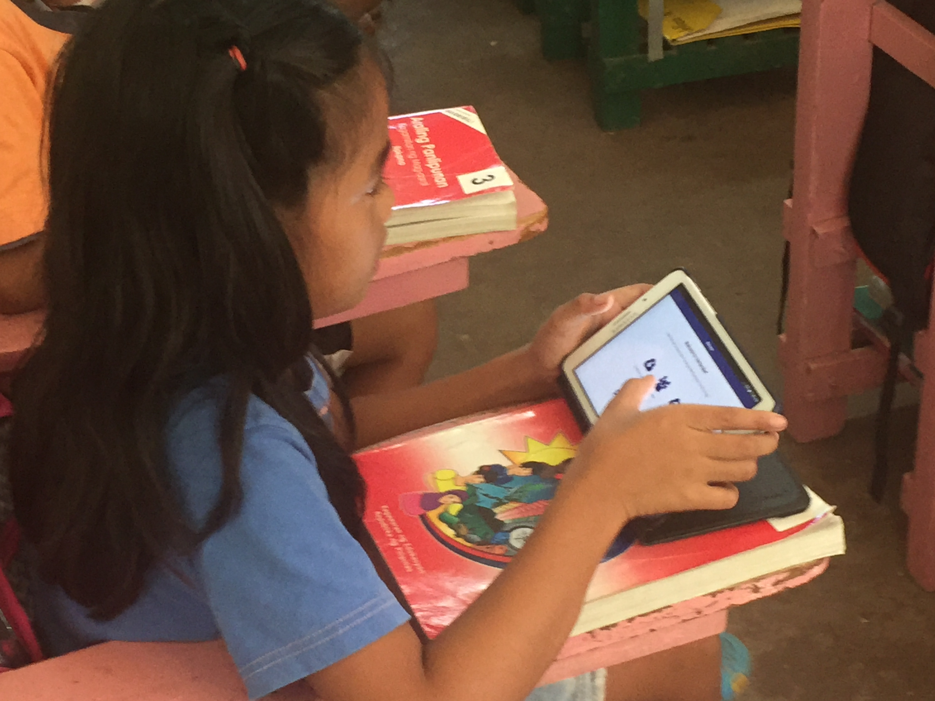
Feedback from teachers and students obtained from school visits

Slide 6



Current content authoring process
Server
Save content
to database
Download
Tablet
(Samsung Galaxy Tab A6)
New Content Authoring Site
http://steppingstone.create.edc.org

Slide 7
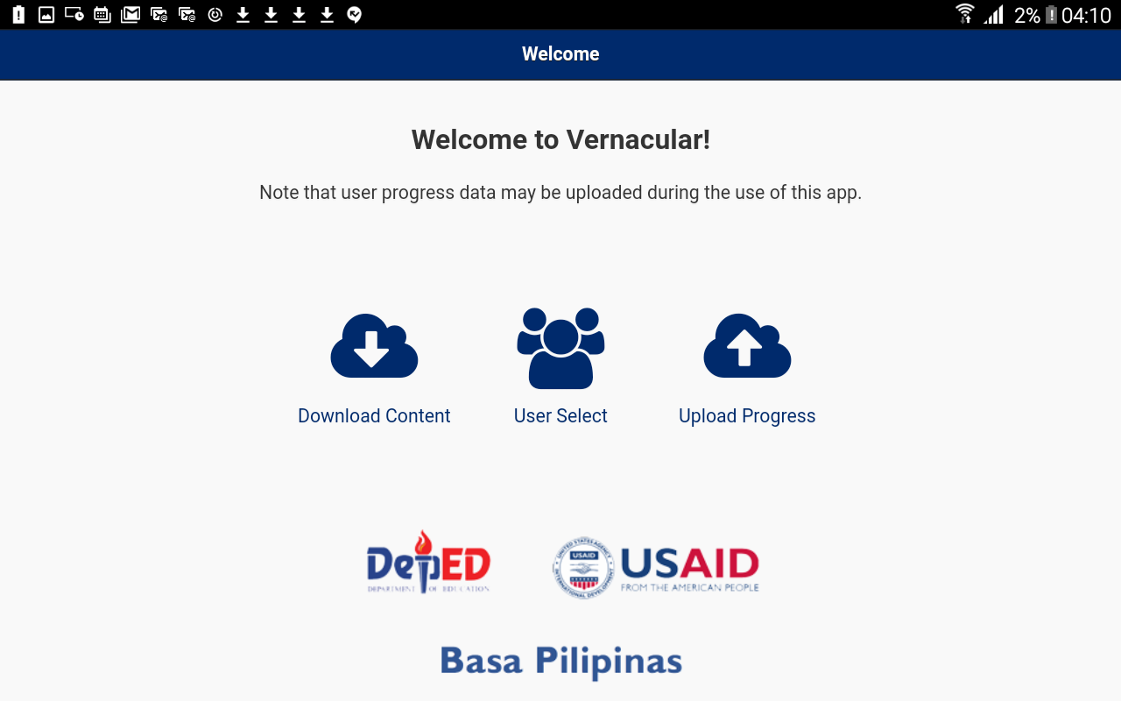
Welcome Screen

Slide 8
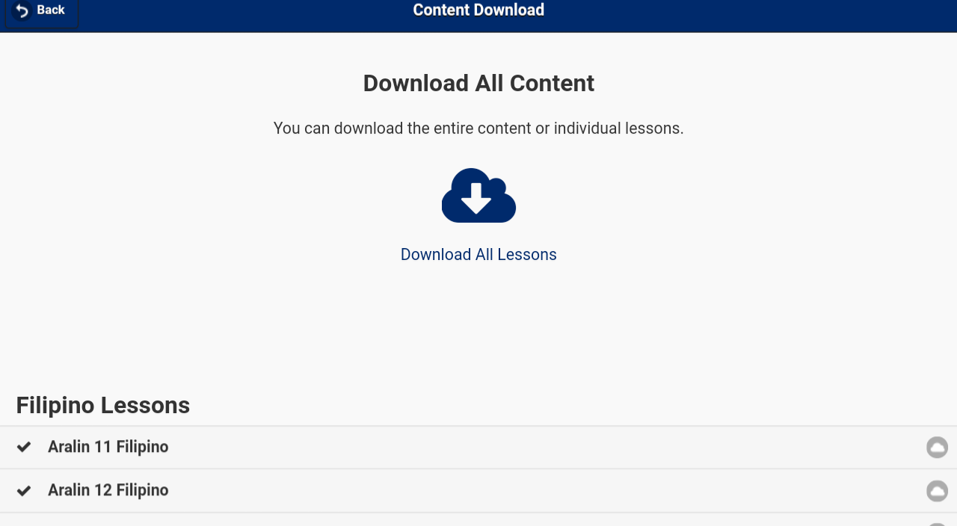
Lessons are downloaded from content authoring site

Slide 9
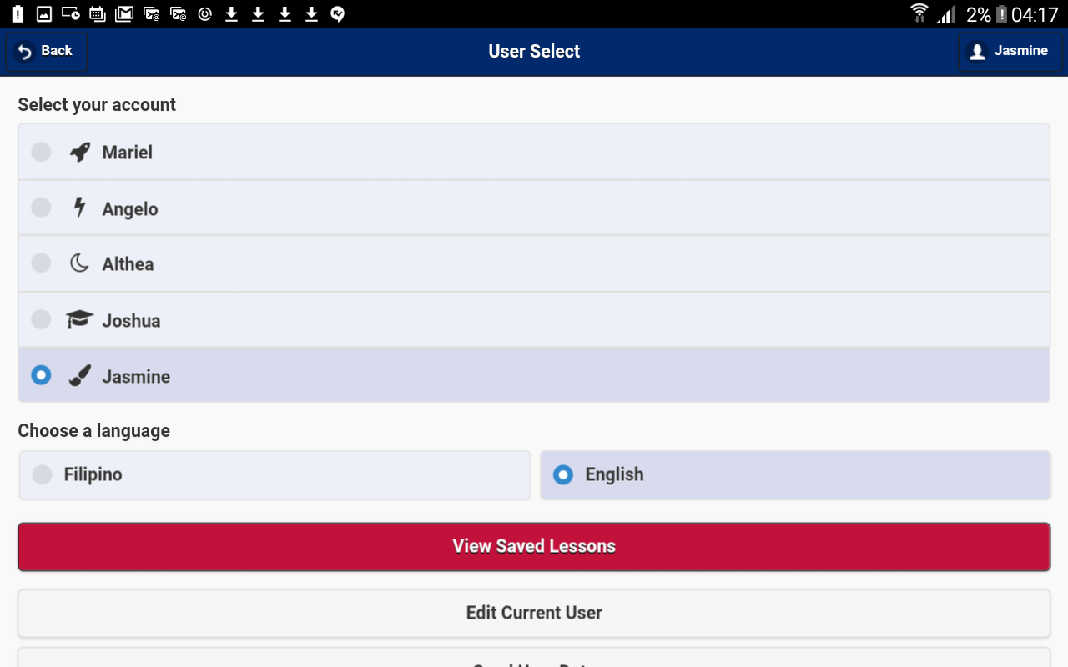
User Select

Slide 10
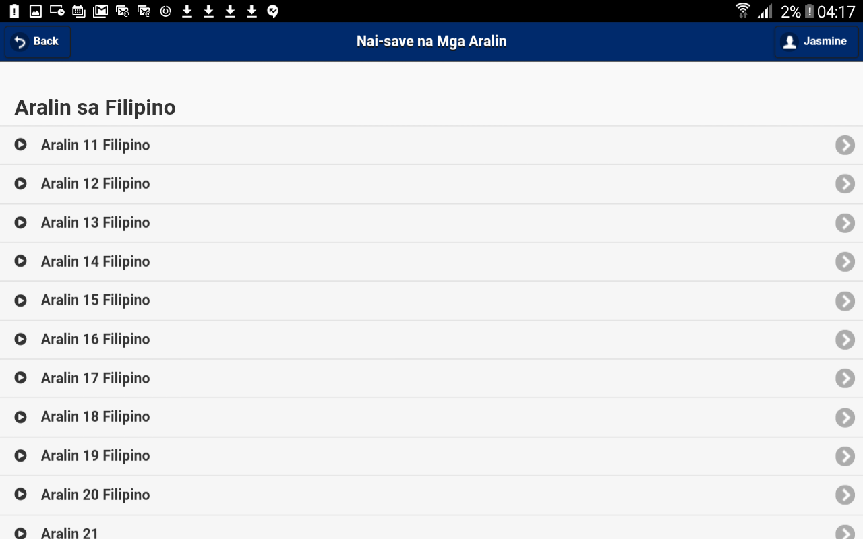
Lesson select screen

Slide 11
User Select

Slide 12
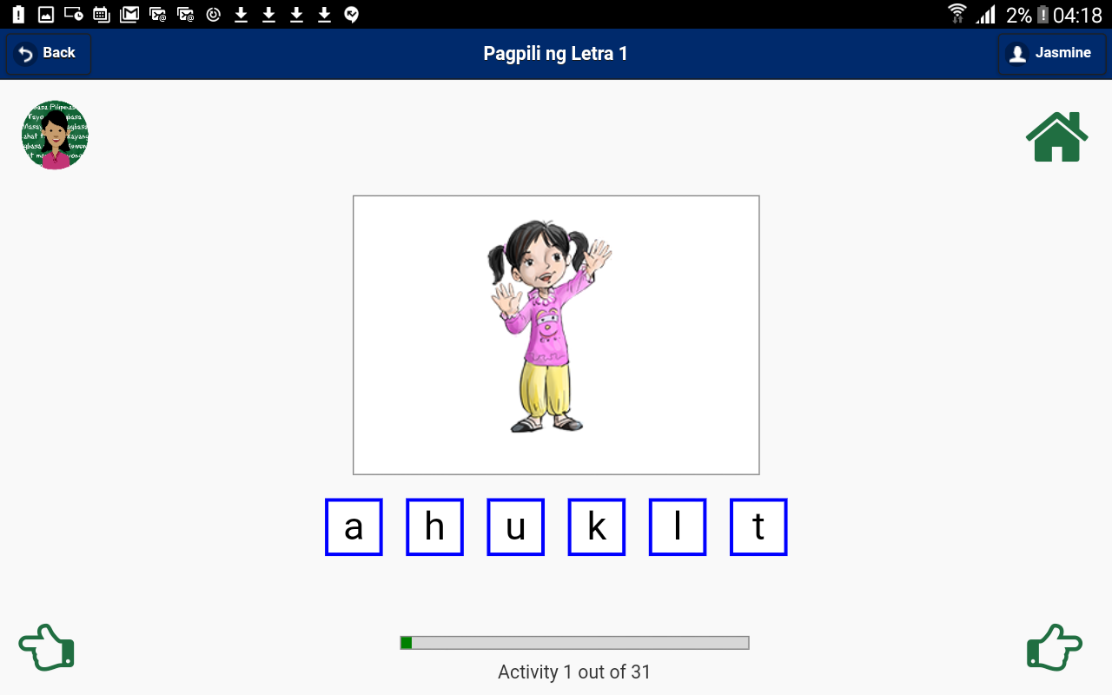
Find the letter that the spoken word starts with
Letters

Slide 13
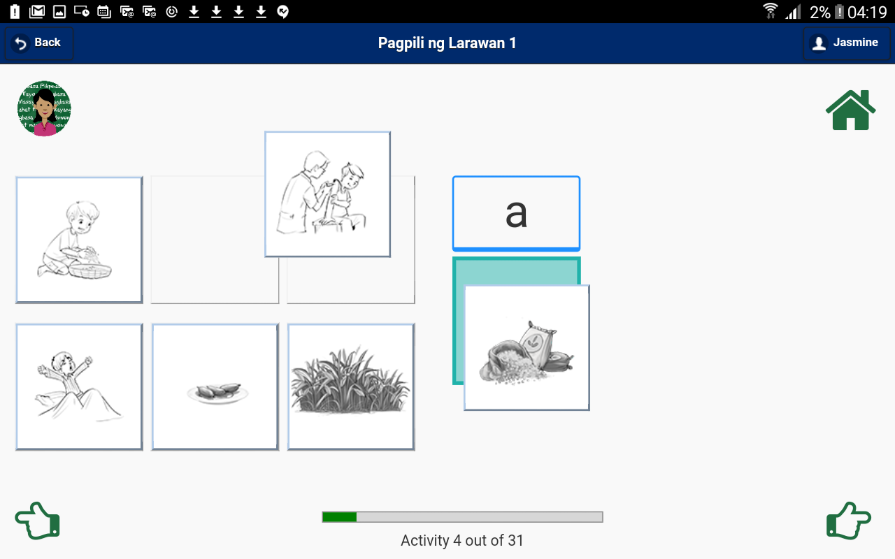
Sounds
Drag picture representing the word to target sound

Slide 14
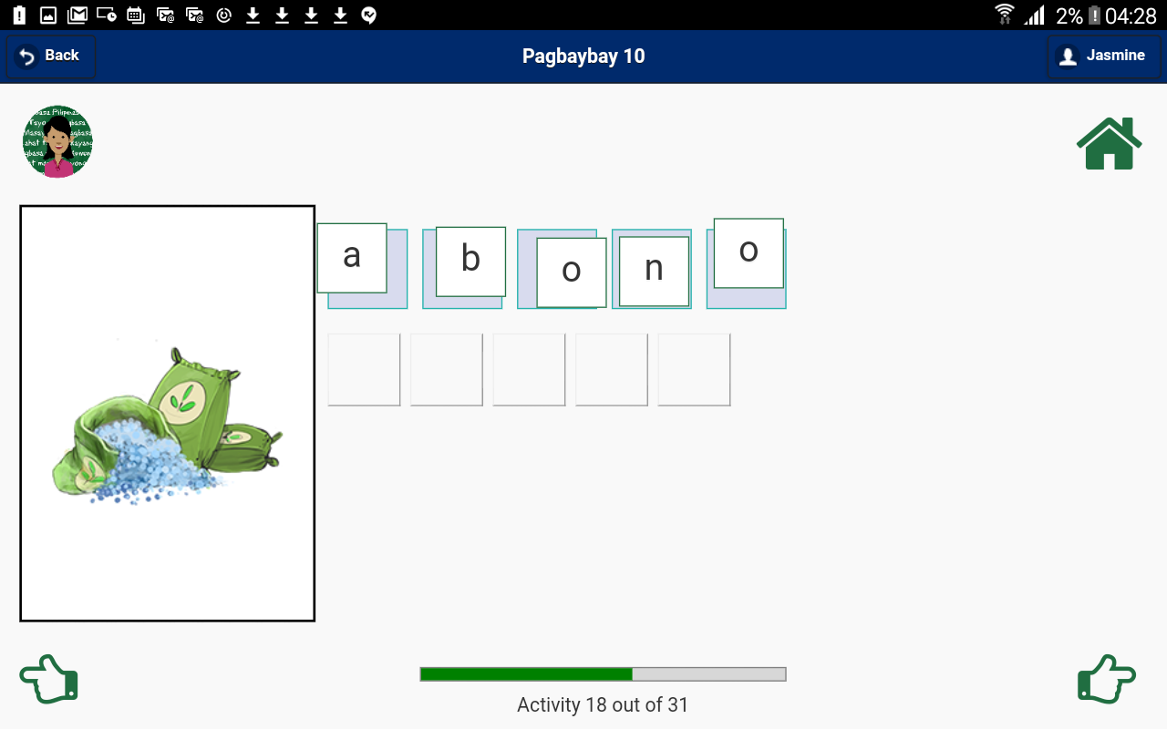
Drawing with Letters
Spell the spoken word via drag and drop

Slide 15
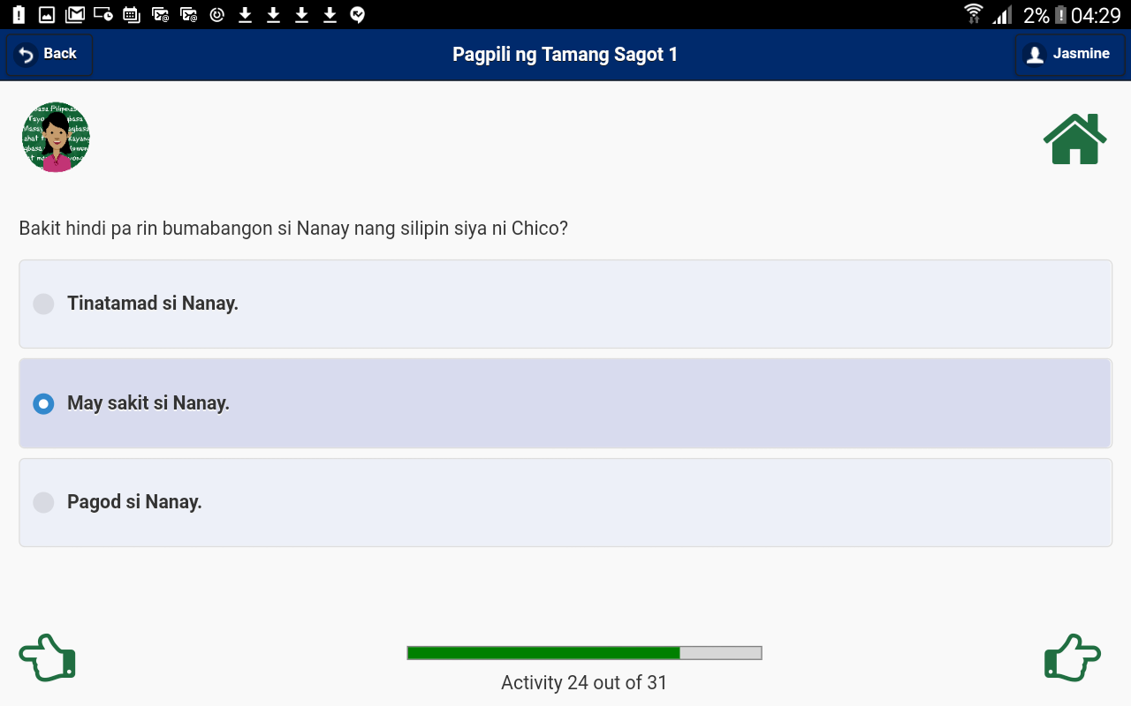
Multiple Choice
Select the correct answer based on the prompt.

Slide 16
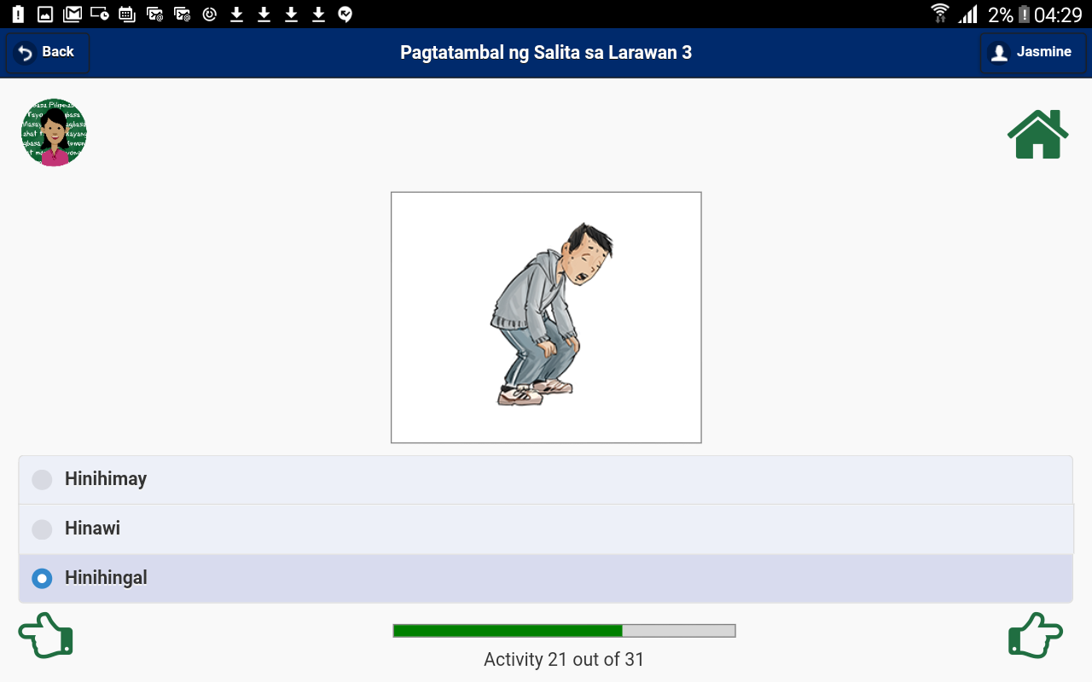
Matching
Select the word that matches the picture clue

Slide 17
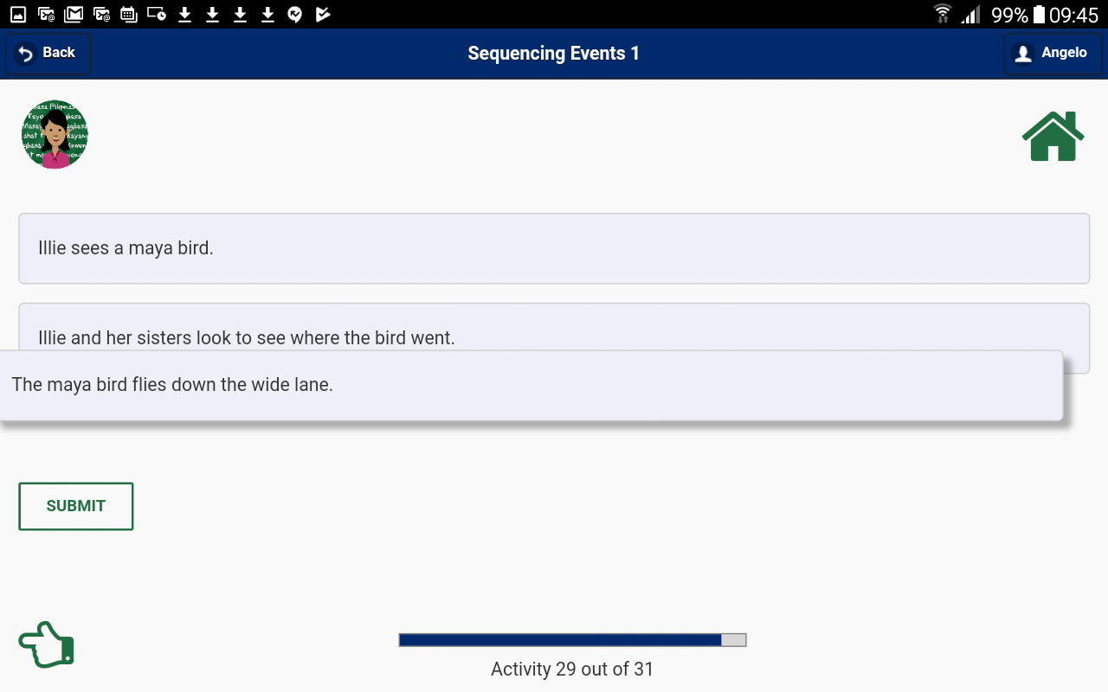
Sequencing
Put the events of the story in the correct sequence

Slide 18
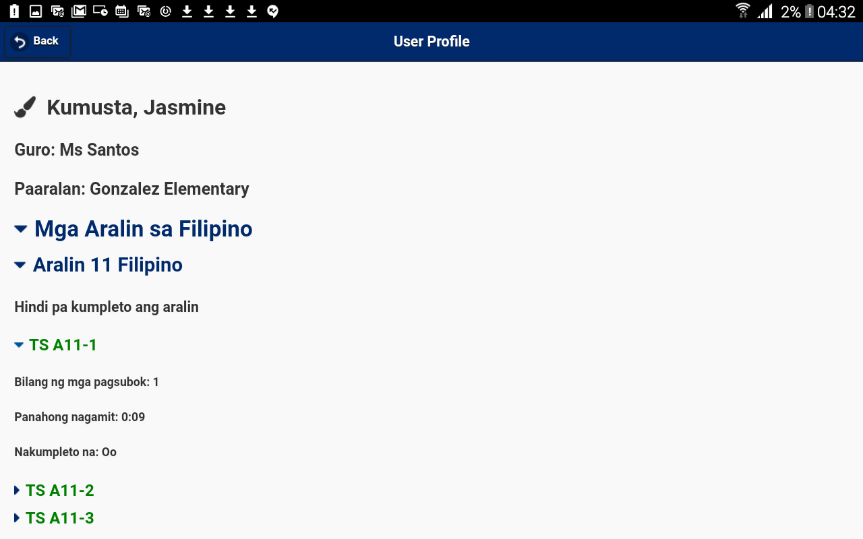
Student Profile Screen

Slide 19
Looking at Student Data
Server
Upload
Progress
Data
Pull down
Progress data
Tablet
Data Analysis

Slide 20
Content Authoring Process 1 (in pilot)
Server
Save content
to database
Download
Tablet
Live Authoring Site

Slide 21
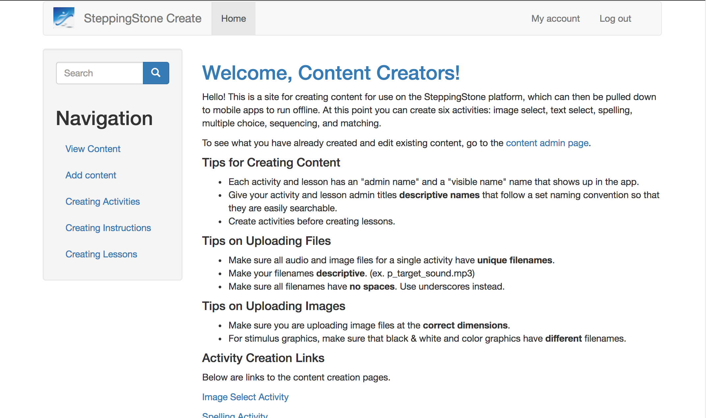
Authoring Site Homepage

Slide 22
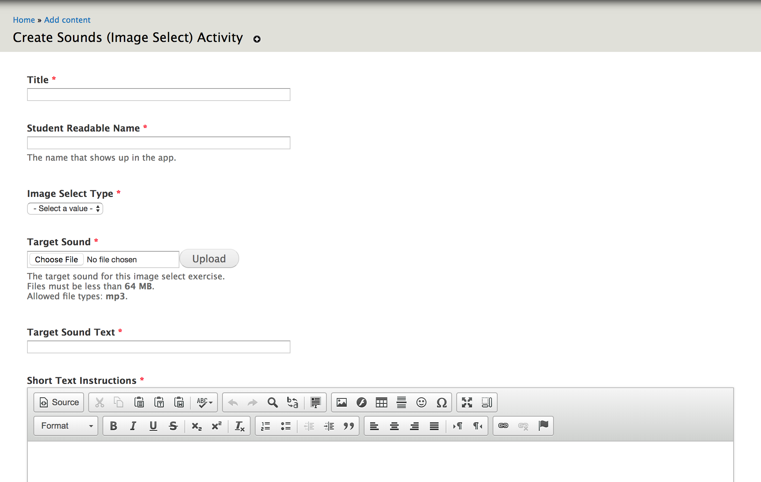
Activity Authoring Screen
Spell the spoken word via drag and drop

Slide 23
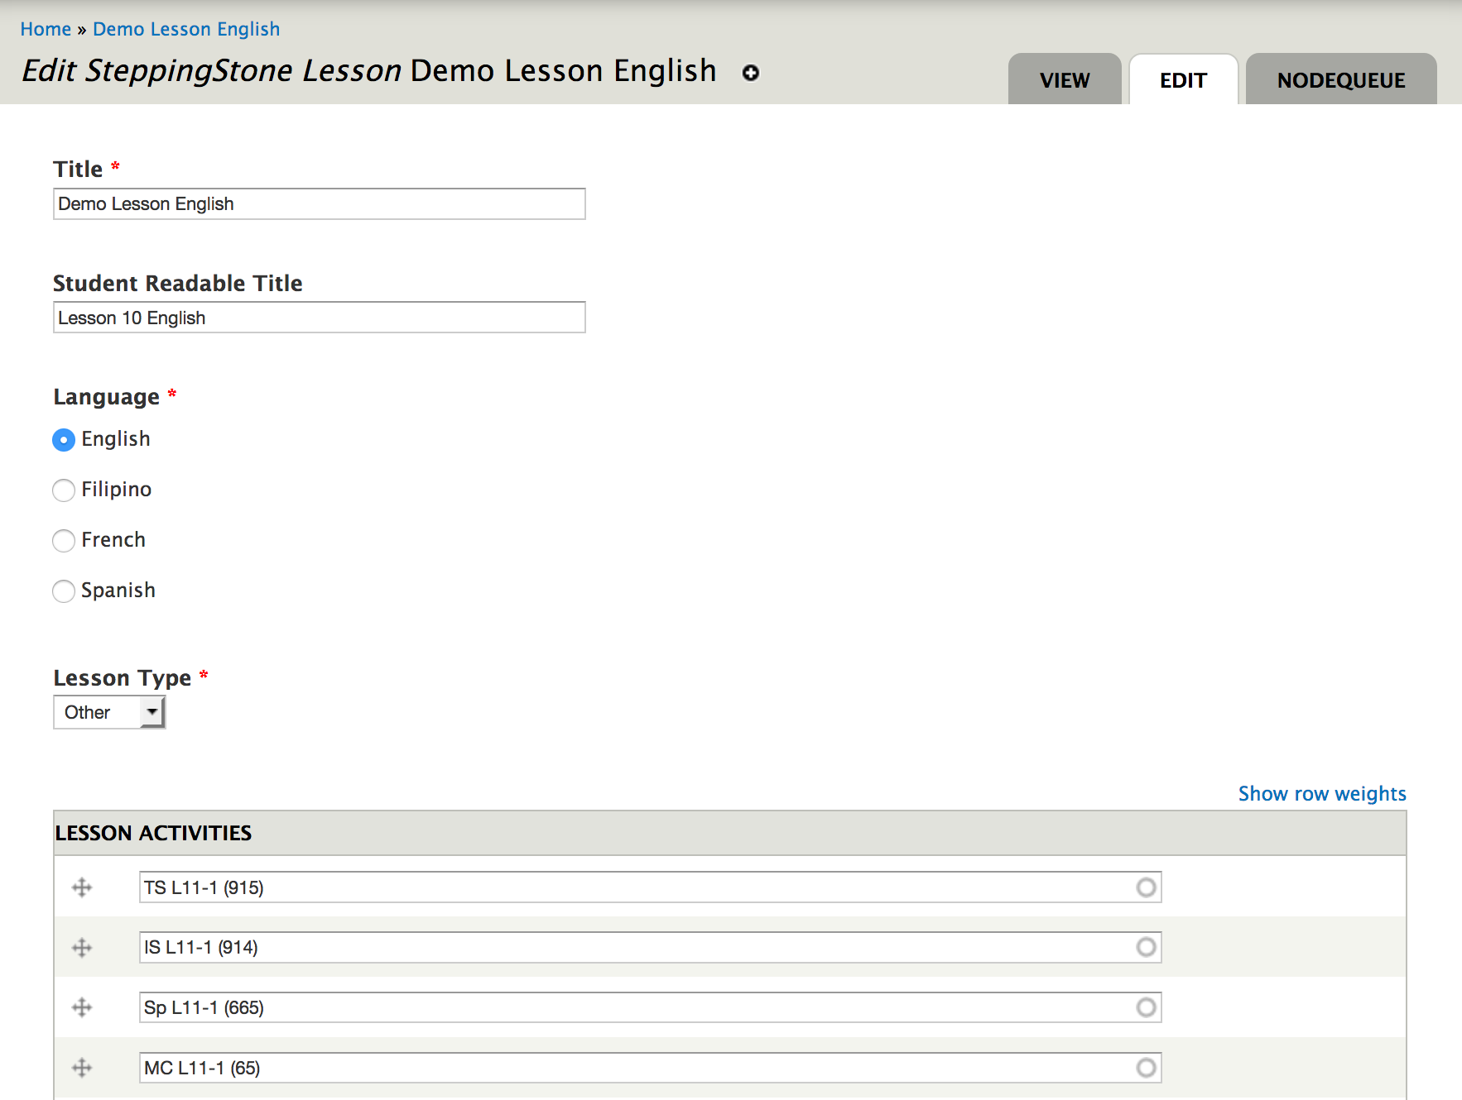
Lesson Authoring Screen
Select Language / Add and Sort Activities

Slide 24
Content Authoring Process 2 (under development)
Server
Save content
to database
Download Zip
Tablet
Transfer Unzipped Files
via thumb drive
Live Authoring Site

Slide 25
Content Authoring Process 3 (proposed)
Save content
to internal database,
ownload zip
Tablet
Transfer Unzipped Files
via thumb drive
Live Authoring Site

Slide 26
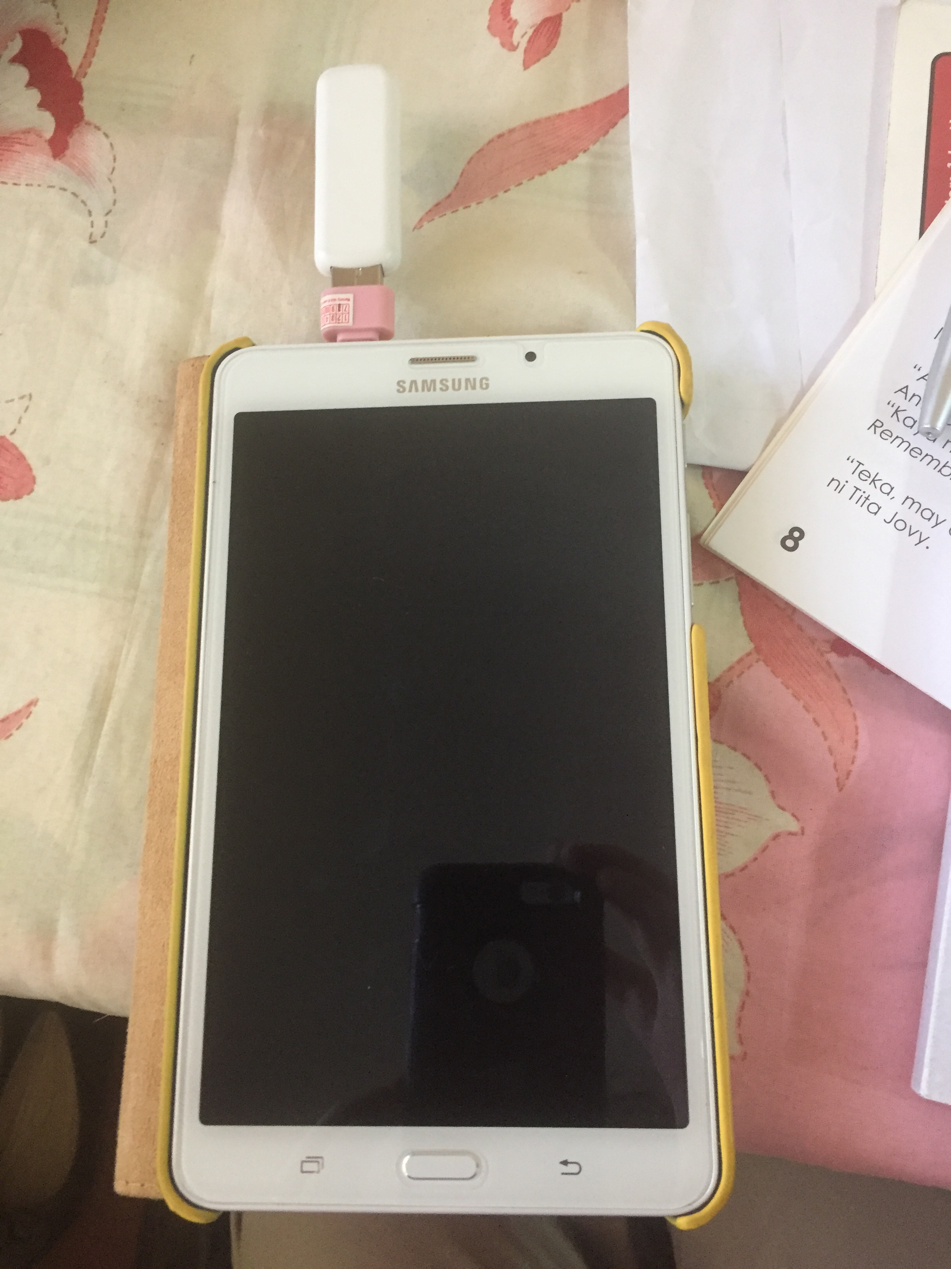
USB with OTG adapter

Slide 27
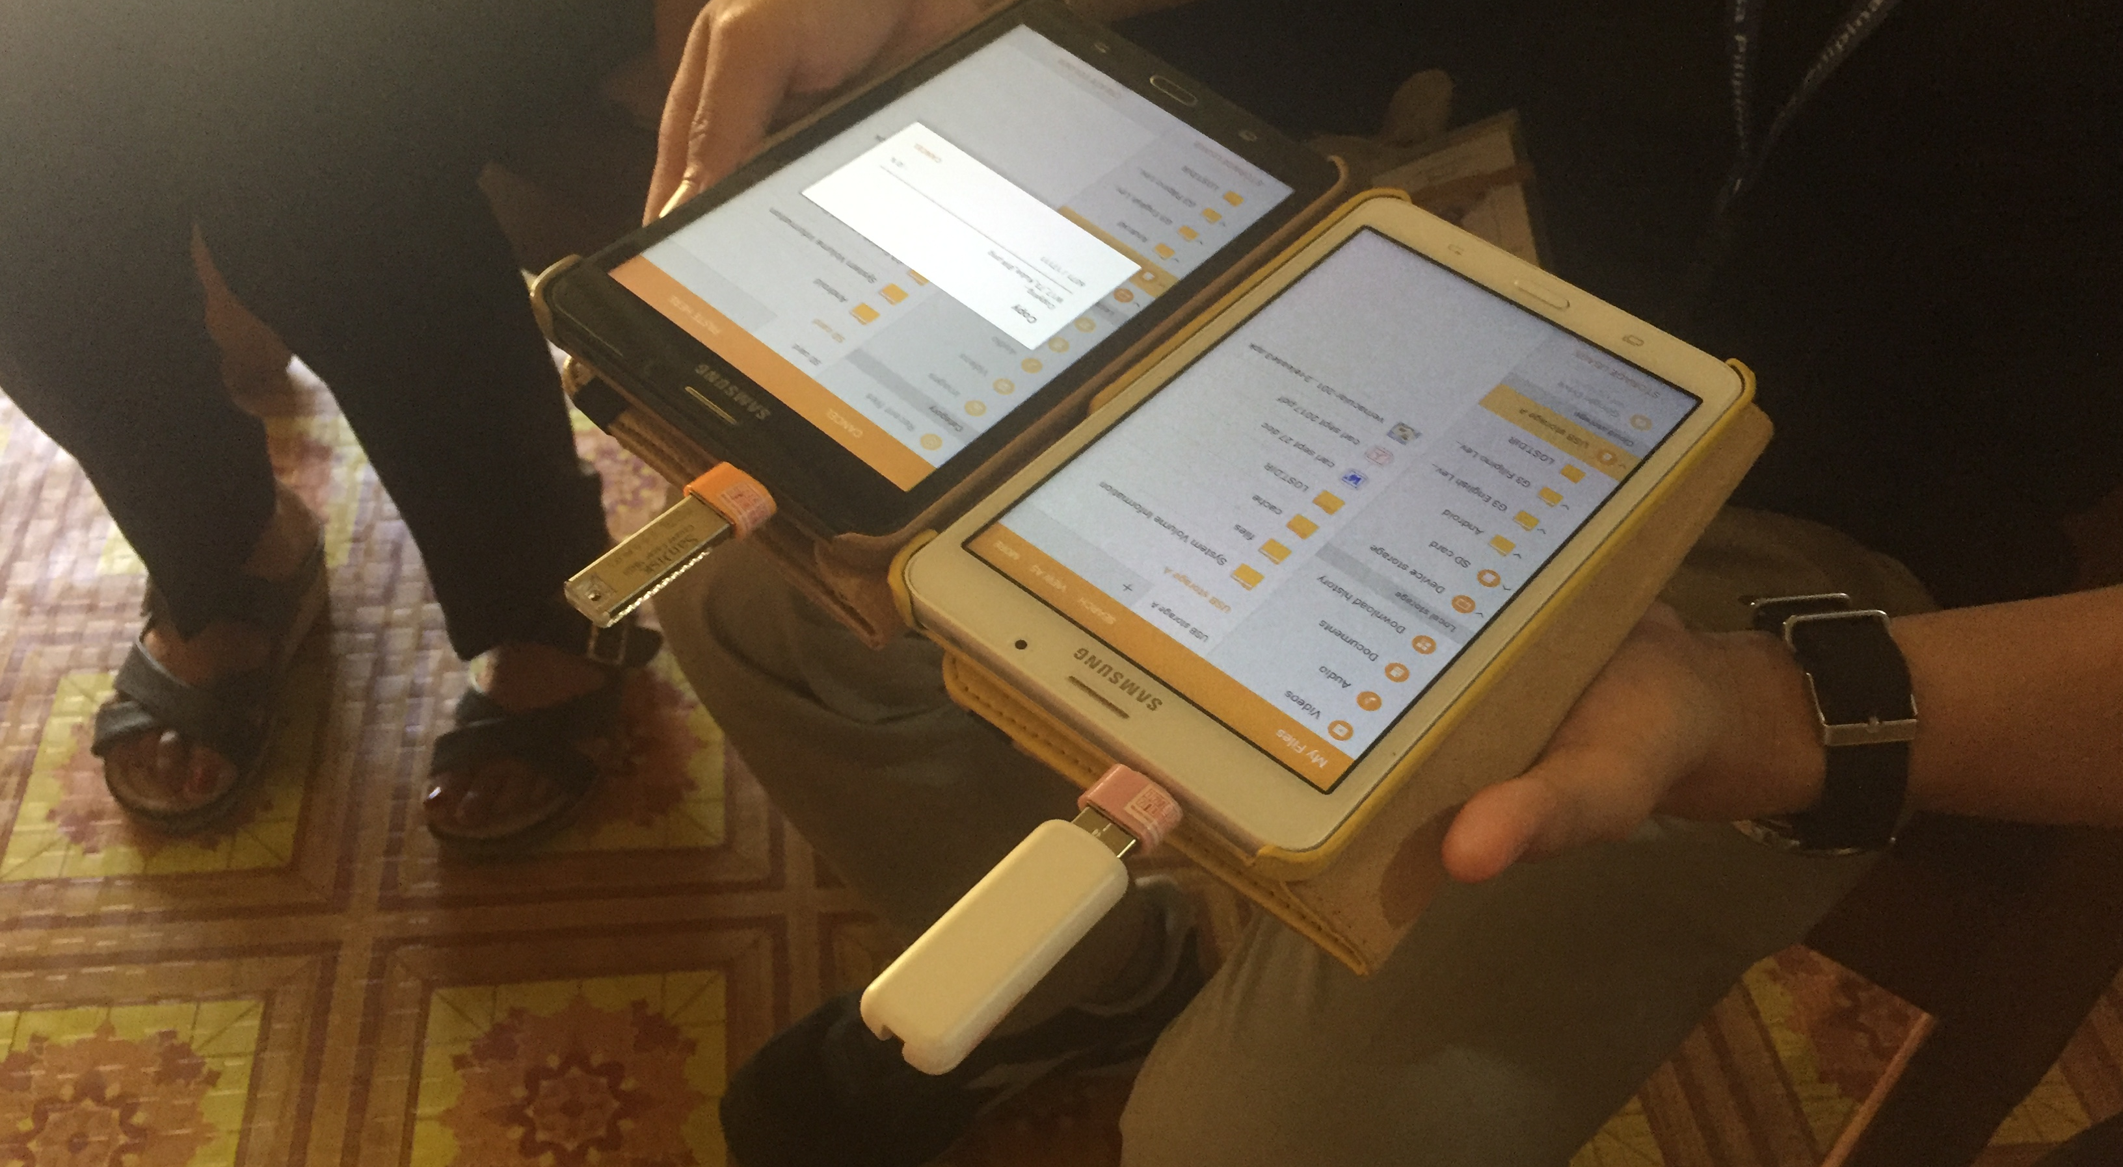
Updating app & content via USB

Slide 28
BASA Overview
We piloted the new Vernacular app in 26 schools as part of the Philippines BASA project.
The app uses the new SteppingStone 3.0 system.
Tested on 369 Tablets in 26 Schools in La Union

